Slide 1



Inventec
Precision Cleaning

Slide 2

Precision cleaning
Market opportunity
Technology
Success stories / references
Inventec overview

Slide 3
Targeted Segments
Industries:
Market Drivers:
Optical
Medical
Military
Electronics assembly
Aerospace
Semi-conductors
Jewelry / micro-mechanics
Retrofit nPB
Retrofit AK225
Displace TDE
Displace TCE and Perc
Water shortage in CA
Solve customer problems

Slide 4
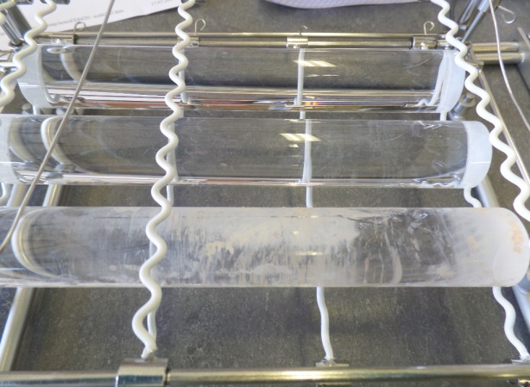
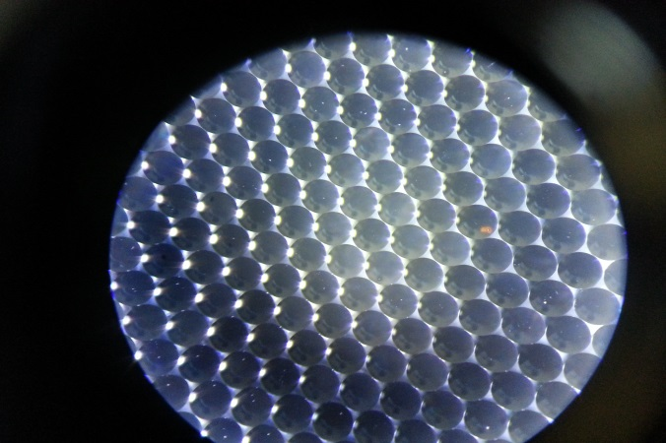
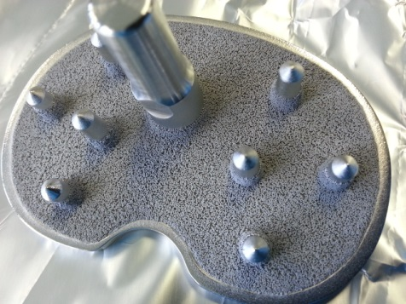
Applications and products

Slide 5
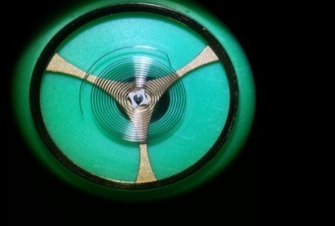
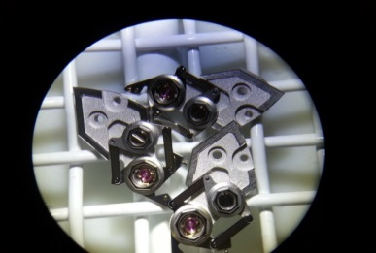
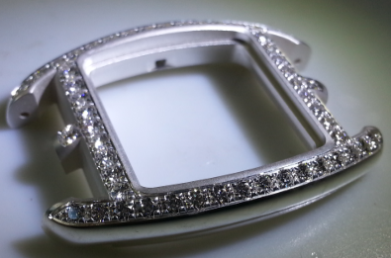
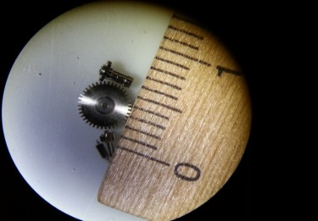
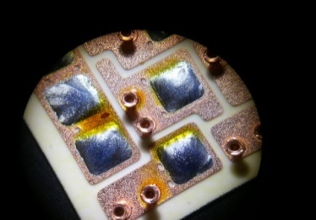
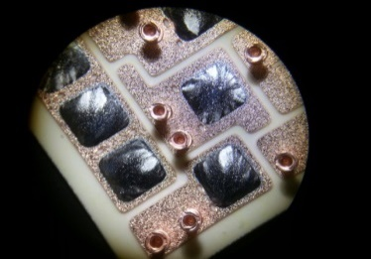
Applications and products

Slide 6
Precision cleaning
Solvency power
Wetting power

Slide 7
Solvency Power
KB index
ASTM D1133
Inventec
Co-solvents
0
HFE71DE
50
HFE72DE
100
150
HFE7100
P41M
P70
P90C
141B
113
TCE
NPB
Low cleaning power
High cleaning power
Environmental issue – Bans / concerns force new formulations
CFCs, HCFCs, VOC (Montreal/Kyoto/REACH Protocols)
Chlorinated solvents, classified CMR 2 (R45)
nPB , classified CMR 2 (toxic, R60, R63)
Inventec’s Co-solvents achieve top cleaning performance
and have low toxicity & Environmental impact

Slide 8
Surface tension
Low surface tension / high wetting power
allow for deep cleaning in micro areas
mN/m
Low cleaning power
80
70
60
DI Water
50
Tap Water
40
Detergents + Water
Cosolvent Topklean
30
Promosolv™ Range
20
10
Inventec
Co-solvents
Flashpoint limitation
High cleaning power
8-mN/m
Boiling point limitation
54
65
100
Temperature °C
Inventec = Best cleaning with lowest Surface Tension

Slide 9
Precision cleaning processes
Separated co-solvents
Combined co-solvents & detergents
Water displacement drying

Slide 10
Co-solvents formulations
Co-Solvents:
3 sumps: Solvents, co-solvents, drying agents
Formulated to dissolve specific contaminants without damaging other materials
2) Combined Co-Solvents & Detergents:
4 sumps: Solvents, Co-solvents, detergent, drying agents
Can clean organic and non-organic parts
Benefits / Customer value:
Superior cleaning power (Kb value > 100, specific targeting of contaminants, deeper cleaning via low surface tension, perfect finishing via drying).
Up to 4 X less expensive than water based cleaning (Capex, water, waste water disposal)
Safe & environmentally friendly: Non-chlorinated, non flammable and non toxic.
Smaller surface footprint

Slide 11
Spot Free Precision Drying
Process - Water displacement:
Dip and displace water into the 71DS2
Rinse N°1 into 71IBuA
Rinse N°2 into 71IBuA
Vapor Rinsing
Condensation drying
Advantages:
Spot free, no halo, no smudge
Super fast drying: 30 sec. to 2 min
Very low surface tension
Low temperature parts / can handle by hand
Non flammable, Non-toxic and Non-explosive
CAS, non-VOCs, -HAPs, -ODCs, -GWCs
Products are reclaimable, no disposal needed

Slide 12
Common Degreasing Process
Vapor phase degreaser with Azeotropes
Drying zone
Distillation / separation
Condenser -20°C
Vapor Phase
Water separator
Topklean EL20A HFE71IPA
HFE-71IPA
Flush
Ultrasonics
Limitations of Solvents:
Not always aggressive enough to clean targets / too aggressive for other materials
Clean organic materials but not salts

Slide 13
Mixed Co-solvents Process
Vapor phase degreaser with mixed co-solvents
Drying zone
Distillation / separation
Condenser -20°C
Vapor Phase
Water separator
Mixed Co-solvents
Hydrocarbon + HFE
Topklean EC-20 HFE71IPA
HFE-71IPA
Flush
Ultrasonics
Mixed co-solvents may improve performance
in standard machines

Slide 14
Separated Co-solvent Process
Separated co-solvent: Formulated Hydrocarbons +HFEs
Co-Solvent
1
Cleaning Process
1. Cleaning
2. Rinsing
3. Rinsing
4. Vapor rinsing
5. Drying
6. Distilling
5
Vapor
4
2
3
6
HFEs
HFEs
Flush
Distillation
Manage each sump perfectly
Separation for optimum performance and minimal product losses

Slide 15
Combined Processes : Detergent + Co-solvent
Combined Detergent and co-solvent process
Full cleaning spectrum: organics & inorganics
For High Tech Precision Cleaning

Slide 16
Drying by water displacement
PROMOSOLV™ HFE-71DS WATER DISPLACEMENT FLUID
5
Exit
Water
HFE vapors
Water Separator
4
1- Dip of wet parts into the Promsolv™
2- Rinse the drying additive
3- Rinse again
4- Vapor rinse
5- Drying zone
Rinsing with HFE
Drying Agent HFE-71DS
1
2
3
Pump
Immediate water removal (within 1 Min)
4x less energy than hot air drying – high yield production

Slide 17
Electronics PCB cleaning
Independent Testing of Cleaning Options
(IPC research – Valtronic Technologies - 2011)
Inventec
Tested15 types of flux residues
Medical customers require Results 8 and above
Superior performance
with Inventec Precision Cleaning

Slide 18
PCB Cleaning Cost
Averages of 5 years of experience : Boards are of 100 x 150mm (IPC source)
Match Medical specs
Match Industrial specs
Best performance AND cost with Separated Co-Solvents

Slide 19
Medical Cleaning – Environmental performance
Independent Testing of Cleaning Options (5 years customer testing)
Bioburden: Met-An-Bioburden-01, Ph. Eur.6eme and EN/ ISO 11737 (number of residual toxic bacterias)
Biocompatibility : EN / ISO 17025 (compatibility with living organisms)
Best environmental results with Separated Co-solvents

Slide 20
Environment and Toxicity
*pending certification from South Coast Air Quality Management District (SCAQMD) for metro Los Angeles air basin
Non toxic, non flammable, environmentally friendly

Slide 21
Sales / technical assessment process
Cleaning – Defluxing - Degreasing
1) Before tank fill
☐ | Sample customer parts to test in Deep River with Inventec equipment
☐ | Check machine gasket samples for compatibility with solvents
☐ | Take sample of current cleaning product to check for contaminants
☐ | Clean residues and contaminants with a brush and IPA
☐ | Change all filters
☐ | Adjust temperatures in the boiling sump and the vapor phase
☐ | Test for leakages
2) Establish customer criteria
☐ | Define specifications expected by customer
☐ | Develop test program with a reasonable number and selection of representative parts
3) During and after tank fill
☐ | Allow 1-2 setup days
☐ | Weekly factory support for one month
☐ | Contact Inventec at 860.526.8300 if something comes up

Slide 22
Sales / technical assessment process
Drying – water displacement
1) Before tank fill
☐ | Sample customer parts to test in Europe with Inventec equipment
☐ | Check machine gasket samples for compatibility with solvents
☐ | Take sample of current cleaning product to check for contaminants
☐ | High-pressure steam clean current unit
☐ | Change all filters
☐ | Adjust temperatures in separators for best separation
☐ | Insulate entire unit
2) Establish customer criteria
☐ | Define types of staining observed by customer
☐ | Develop test program with a reasonable number and selection of representative parts
3) During and after tank fill
☐ | Allow 3-5 setup days
☐ | Weekly factory support for one month
☐ | Contact Inventec at 860.526.8300 if something comes up

Slide 23
Key contacts
Inventec Performance Chemicals USA:
  500 Main Street, Suite 18, Deep River CT 06415
  860 526 8300
  www.inventec.dehon.com
Sales:
  Leigh Gesick
  lgesick@inventec.dehon.com
  860 301 7851
Technical Support:
  Ed Watkins PHD, Senior Chemist (USA) ewatkins@inventec.dehon.com
  Gabiel Gutierez (Mexico) ggutieres@inventec.dehon.com
  Patrick Duchi (Europe) pduchi@inventec.dehon.com

Slide 24
References and success stories
Medical
Optical
Micromechanics
Aerospace
Military

Slide 32
Appendix
Inventec Performance Chemicals
USA, Deep River, CT

Slide 33
Inventec Performance Chemicals

Slide 34




Company Organization
Inventec Performance Chemicals is part of the Dehon Group
GROUP DEHON
HQ in Paris (France)
100% owned by the family Dehon
Since 1874
>500 employees over 17 sister companies in Europe, Asia & America
One of the first high-tech Performance chemicals companies in Europe.
Chemicals for the B2B and commercial automotive market.
Liquefied gasses for the re-frigeration, air conditioning and heating market
… more then 140 years experienced in different chemical fields

Slide 35
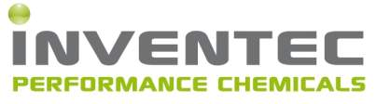



Company Organization
Soldering, cleaning & coating materials for electronics and semicunductor
Surface treatment and precision cleaning materials for various markets
Specialty chemicals for foam expansion, aerosols and chemical synthesis

Slide 36
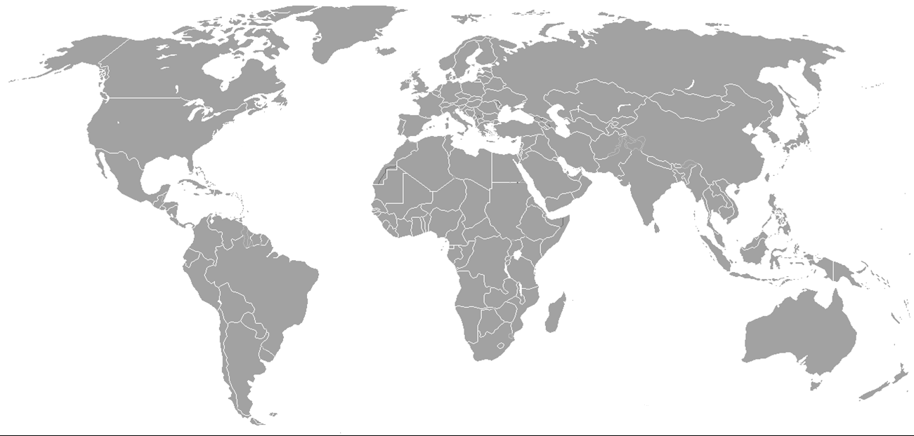
Global operations
Deep River, CT
Bry/ Paris
St-Priest
Shanghai
Guadalajara
Yverdon
Les Bains
Kuala Lumpur
11 subsidiaries and a distributor network

Slide 37


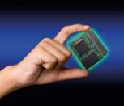


Main markets
…with a common need:
A requirement in common: High Reliability
Automotive • Industrial • Power Electronics •
Energy • Aerospace • Rail • Semiconductor

Slide 38
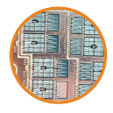
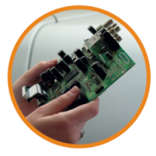

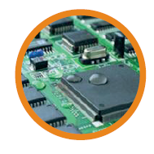
Main Brands
EcorelTM solder paste: SMT, Package on Package, Jet Printing, Die Attach
EcofrecTM flux: PTH, Package on Package, Flip Chip
Amtech: Paste, Flux, Wires, Preforms, Spheres
Promoclean aqueous cleaners: Defluxing, Maintenance
TopkleanTM solvent cleaners: Defluxing, Maintenance
Coatings: fluoropolymers, acrylic toxic-free, urethane UV solvent-free

Slide 39

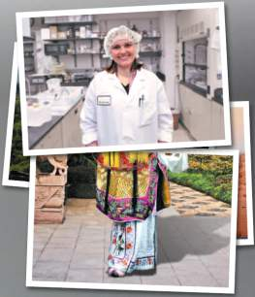
Consistency site to site
ISO 9001:2008 Certification
Technology transfer between our production sites
Consistent quality among continents
Local expert team
Technical application support on site
Optimizing quality and yield

Slide 40
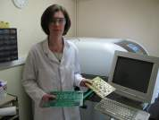
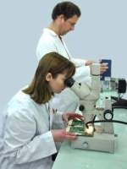
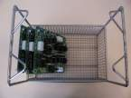

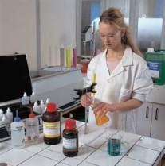
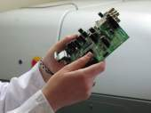
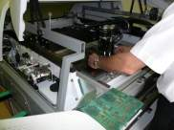
Applications Laboratories
Printing
Reflow
Cleaning
Coating

Slide 41







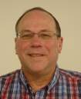
US Team Leaders
Leigh Gesick
Sales / Coordination
David Reitz
Finance / Operations
Wendy Gesick
Production
Jean-Noel Poirier
Management
Gilbert Roberge
Technical Support
Michael Gesick
Powder Devt & Production
Ed Watkins
R&D

Slide 42




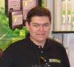
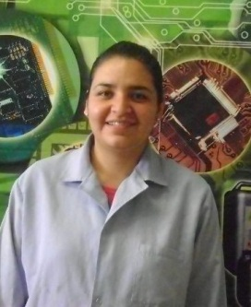
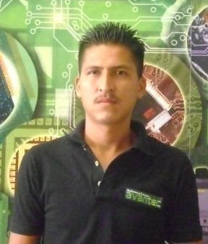
Mexican Team Leaders
Rossy Hernandez
Marketing
Ana Maria MENDOZA
Materials and Logistics
Diana QUINTERO
Operations
Rodrigo SANCHEZ
Management
Gabriel GUTIEREZ
Technical Support
Marisol MORALES
Quality
Pedro BRAMBILA
Manufacturing

Slide 43









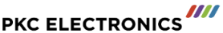



























Some customer references

Slide 44


@Inventec_BUEL
www.inventec.dehon.com

